Slide 1
Signals & Systems
Module 3

Slide 2



The trigonometric Fourier series representation of a periodic signal x(t) with period T is given by:
where the coefficients a_{n} and b_{n} are given by:
The trigonometric Fourier series representation expresses the original signal as a sum of sine and cosine functions of different frequencies. The n’th term in the series corresponds to a frequency of Hz. The coefficients a_{n} and b_{n} represent the amplitudes of the cosine and sine components, respectively.

Slide 3


Properties of the trigonometric Fourier series representation:
Periodicity: The Fourier series representation is periodic with the same period as the original signal.
Convergence: The Fourier series converges to the original signal under certain conditions, such as if the signal is piecewise continuous and has a finite number of discontinuities.
Even and odd functions: If the original signal is even, i.e., x(-t) = x(t), then the Fourier series only has cosine terms and no sine terms. If the original signal is odd, i.e., x(-t) = -x(t), then the Fourier series only has sine terms and no cosine terms.
Parseval's theorem: The total power of the signal, given by
, is equal to the sum of the powers of the Fourier coefficients, given by.
5. Symmetry: If the original signal has certain symmetries, such as odd or even symmetry, then some of the Fourier coefficients will be zero, simplifying the Fourier series.

Slide 4

Write the Fourier Transform of Cosωct and Sinωct
The Fourier transform of a continuous-time signal x(t) is given by:
where omega is the angular frequency in radians per second.

Slide 5



Fourier Transform of
Using the identity
we can write:
Taking the Fourier transform of both sides, we get:

Slide 6
Using the properties of the Fourier transform, we can evaluate these integrals as follows:
where is the Dirac delta function.
Therefore, the Fourier transform of is a pair of impulses at and - .

Slide 7



Fourier Transform of
Using the identity
we can write:
Taking the Fourier transform of both sides, we get:

Slide 8
Using the properties of the Fourier transform, we can evaluate these integrals as follows:
Therefore, the Fourier transform of is a pair of complex impulses at
and - with opposite imaginary parts.

Slide 9

Continuous Time Fourier Transform
Discrete-Time Fourier Transform:
Note that both equations use the same notation for the transformed signal, which is represented by X(ω). However, the Fourier Transform is performed over a continuous-time signal x(t) while the DTFT is performed over a discrete-time signal x[n].

Slide 10


Formulate the DTFT of x(n)={1,1,1,1,1,1,0,0}
The Discrete-Time Fourier Transform (DTFT) of a sequence x(n) is given by:
where omega is the normalized frequency in radians per sample.
In the case of the sequence x(n) = {1,1,1,1,1,1,0,0}, we have:

Slide 11


since all other terms are zero. Using the formula for the sum of a geometric series, we can simplify this as:
If we plug in = 0, we get:
which is the value of the DC component of the sequence. For other values of omega, we can simplify
as follows:

Slide 12



Therefore, the DTFT of the sequence $x(n) = {1,1,1,1,1,1,0,0}$ is given by:

Slide 13
The DTFT of a sequence x(n) is defined as:
The DTFT of x(n)={1,1,1,1,1,1,0,0} is:
Therefore, the DTFT of x(n) is 6 for all frequencies w.

Slide 14
Formulate the differences between time variant and time invariant systems
Definition: A time variant system is a system whose output changes with respect to time, while a time invariant system is a system whose output remains the same for a given input, regardless of when the input is applied.
Mathematical Representation: A time variant system is typically represented using a time-varying function or equation, while a time invariant system is represented using a time-invariant function or equation.
Impulse Response: A time variant system has a different impulse response at different times, while a time invariant system has the same impulse response at all times.

Slide 15


Time-Variant System:
Time-Invariant System:

Slide 16

Formulate Fourier Transform for a real function.
The Fourier transform of a real function is a complex-valued function that represents the frequency domain representation of the original function. The mathematical expression for the Fourier transform of a real function f(t) is given by:
where F(ω) is the Fourier transform of f(t) and j is the imaginary unit. Note that the Fourier transform of a real function is generally a complex function, with both a real and imaginary part.
If f(t) is an even function, then the Fourier transform F(ω) is also even, meaning that its real part is even and its imaginary part is odd.
If f(t) is an odd function, then the Fourier transform F(ω) is also odd, meaning that its real part is odd and its imaginary part is even.

Slide 17

The inverse Fourier transform for a real function can be obtained by taking the complex conjugate of the Fourier transform, i.e.,
where F(ω) is the Fourier transform of f(t).

Slide 18
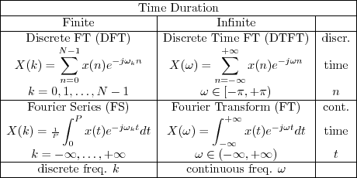
Describe the relation between DFT to Fourier Series.
The Discrete Fourier Transform (DFT) and Fourier Series are related concepts in the field of signal processing. The Fourier Series is a mathematical technique that is used to represent a periodic function as a sum of sinusoidal functions of different frequencies. The DFT, on the other hand, is used to compute the frequency spectrum of a discrete-time signal by decomposing it into a sum of complex sinusoidal functions.

Slide 19
An LTI (Linear Time-Invariant) system is a type of system that is widely used in the field of signal processing. Such systems have the following important properties:
Linearity: An LTI system is linear if it satisfies the principle of superposition, which means that if two input signals are applied to the system simultaneously, the output is the sum of the individual responses to each input signal. Mathematically, this property can be expressed as follows:
y(n) = a x1(n) + b x2(n) -> a y1(n) + b y2(n)
where x1(n) and x2(n) are the input signals, y1(n) and y2(n) are the corresponding output signals, and a and b are constants.
Time-Invariance: An LTI system is time-invariant if its output depends only on the current input and not on the past or future inputs. This means that the system behaves the same way regardless of when the input is applied. Mathematically, this property can be expressed as follows:
y(n) = T{x(n)} -> y(n-k) = T{x(n-k)}
where T is the system operator and k is any constant.

Slide 20
Shift-Invariance: An LTI system is shift-invariant if its output is shifted in time by the same amount as the input. This means that the system output is not affected by the time at which the input is applied. Mathematically, this property can be expressed as follows:
y(n) = T{x(n)} -> y(n-k) = T{x(n-k)}
Superposition: An LTI system is superposition if the response to the sum of two inputs is equal to the sum of the individual responses of the inputs. Mathematically, this property can be expressed as follows:
T{a x1(n) + b x2(n)} = a T{x1(n)} + b T{x2(n)}
where x1(n) and x2(n) are the input signals, and a and b are constants.
Frequency Response: An LTI system has a frequency response that is characterized by its transfer function. The transfer function describes how the system responds to sinusoidal inputs of different frequencies. The frequency response can be used to determine the output of the system for any input signal using the convolution theorem.

Slide 21
Duality and conjugation properties of Discrete Fourier Transform
The Duality property of the Discrete Fourier Transform (DFT) states that if we swap the roles of the time-domain signal and the frequency-domain signal, the DFT remains the same, up to a scaling factor. In other words, if we apply the DFT to a signal x(n) to obtain X(k), and then apply the DFT to X(k) to obtain x(n), we obtain a scaled version of the original signal x(n).
The Conjugation property of the DFT states that if we take the complex conjugate of the input signal x(n), the resulting frequency-domain signal X(k) is the mirror image of the original frequency-domain signal X(k), flipped around the origin (i.e., reflected about the real axis). Mathematically, this property can be expressed as follows:
DFT {x*(n)} = X*(-k)
where x*(n) denotes the complex conjugate of the input signal x(n), X*(-k) denotes the complex conjugate of the frequency-domain signal X(k), and k is any integer.

Slide 22
Orthogonality of two Signals
Two signals are said to be orthogonal if their inner product (or dot product) is zero. Mathematically, the inner product of two signals x(t) and y(t) is defined as:
⟨x, y⟩ = ∫x(t) y*(t) dt
where y*(t) denotes the complex conjugate of the signal y(t) and the integral is taken over the entire domain of t.
If the inner product of two signals is zero, i.e., ⟨x, y⟩ = 0, then the two signals are said to be orthogonal.

Slide 23
advantages of DTFT over DFT
The main advantage of the Discrete-Time Fourier Transform (DTFT) over the Discrete Fourier Transform (DFT) is that the DTFT provides a continuous and exact representation of the frequency content of a discrete-time signal, while the DFT provides a discrete and sampled representation of the frequency content.
The DTFT is defined for all frequencies and provides a continuous and periodic spectrum for periodic signals, which can be useful for analyzing and designing filters. In contrast, the DFT is defined only for a finite number of frequencies and provides a discrete spectrum for a finite-length sequence of samples.
Additionally, the DTFT is an exact representation of the signal's frequency content, while the DFT is an approximation due to the truncation of the signal to a finite length. This can lead to spectral leakage and other artifacts in the DFT.

Slide 24

Discrete Fourier Transform:
where N is the length of the input sequence x[n].
Discrete-Time Fourier Transform:
The main difference between the two transforms is that the DFT is computed over a finite-length sequence x[n] of length N, while the DTFT is computed over an infinite-length sequence x[n]. Additionally, the DFT computes a finite set of discrete frequency values k=0,1,...,N-1, while the DTFT is defined for all frequencies
= ,

Slide 25
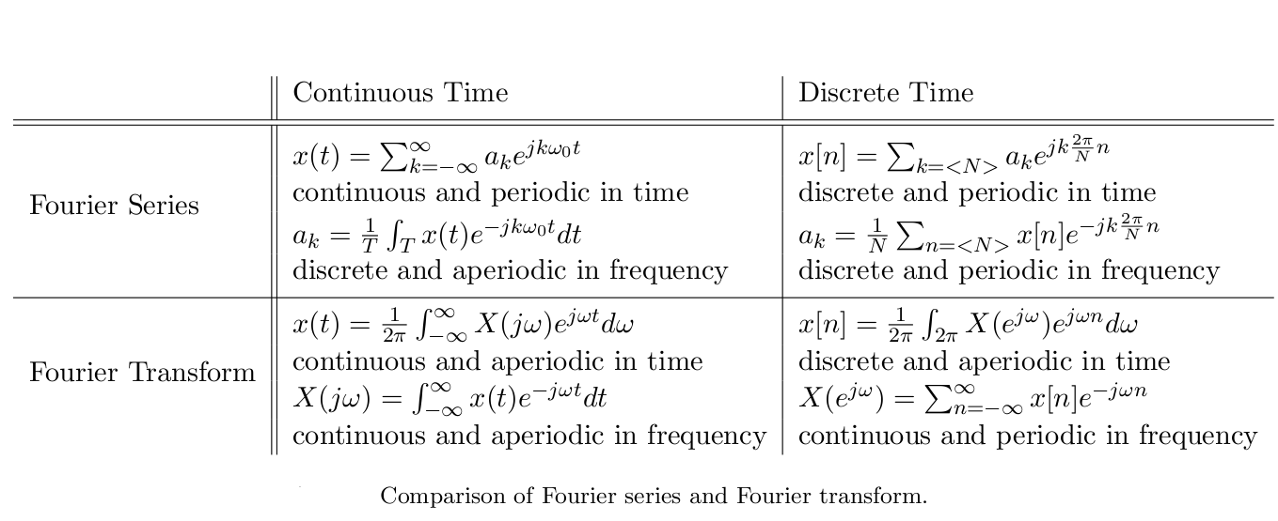

Slide 26


Write the complex form of a Fourier Series f(x) defined in the interval (c, c+2l)
The complex form of a Fourier Series for a function f(x) defined in the interval (c, c+2l) can be written as:
where c_{n} are the complex Fourier coefficients given by:
This representation expresses the function f(x) as a sum of complex exponential functions with frequencies that are integer multiples of the fundamental frequency 1/(2l). The coefficients c_{n} represent the amplitudes and phases of the complex exponential functions, and can be computed using the Fourier series formula.

Slide 27

represents the complex sinusoid with frequency
And phase of
the coefficients c_{n} represent the amplitude and phase of each complex sinusoid in the series.

Slide 28

Formulate the Fourier Series representation of a signal in terms of orthogonality
Let f(x) be a periodic signal with period T and let the set of orthogonal functions {ϕ_{n(x)}} be defined as:
where n is an integer. These functions are orthogonal over one period of f(x), which means that:
= T for n = m
= 0 for n =! m
where * denotes the complex conjugate. This means that the set of orthogonal functions form a basis for the space of periodic signals with period T.

Slide 29


The Fourier Series representation of f(x) can be written as:
where the Fourier coefficients c_{n} are given by:
This representation expresses the periodic signal f(x) as a linear combination of the orthogonal functions ϕ_{n(x)}, with the coefficients c_{n} representing the amplitude and phase of each component. The orthogonality property of the ϕ_{n(x)} functions ensures that the Fourier coefficients are unique and allows for efficient computation of the Fourier Series using numerical algorithms.

Slide 30

Explain the diffentiation and convolution property of Fourier Transform
The differentiation property of the Fourier Transform states that taking the Fourier Transform of a derivative of a function is equivalent to multiplying the Fourier Transform of the function by a variable that represents the frequency domain. Mathematically, if F{f(x)} represents the Fourier Transform of f(x), then:
where i is the imaginary unit and ω is the frequency variable in the Fourier Transform.
The convolution property of the Fourier Transform states that convolution in the time domain is equivalent to multiplication in the frequency domain. Mathematically, if F{f(x)} and F{g(x)} represent the Fourier Transforms of f(x) and g(x), respectively, then:
where * denotes convolution in the time domain and · denotes multiplication in the frequency domain.

Slide 31
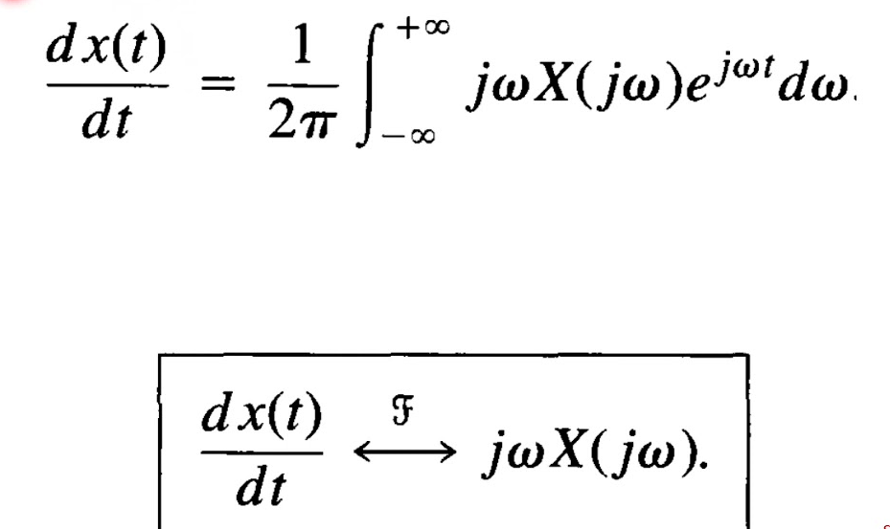

Slide 32
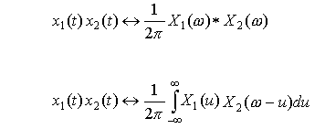

Slide 33
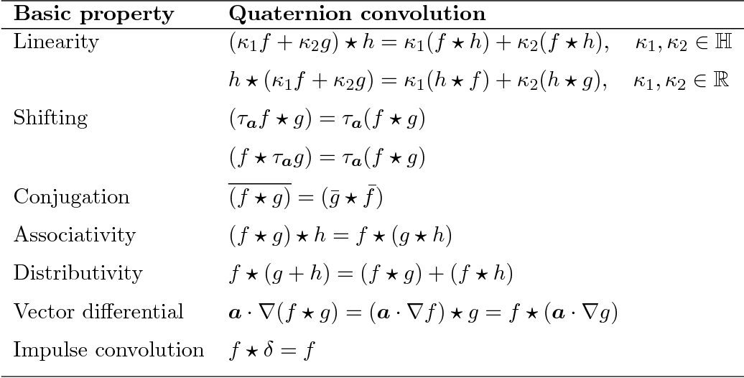

Slide 34
convergence condition on Fourier series.
The convergence of Fourier series depends on the properties of the function being analyzed, such as its regularity and decay rate of its Fourier coefficients. The convergence can be analyzed in terms of pointwise and uniform convergence, and can be affected by the type of convergence considered and the numerical methods used for computation.

Slide 35



The Fourier series of a periodic function f(x) with period 2pi converges to f(x) under the following conditions:
The convergence is pointwise, which means that the Fourier series converges to f(x) at each point x where f(x) is continuous. At the points where f(x) has a discontinuity, the Fourier series converges to the average of the left and right limits of f(x).

Slide 36





Find the Fourier transform of x(t) = u(t)
The Fourier transform of x(t) = u(t) can be expressed as:
Thus, the Fourier transform of x(t) = u(t) is:

Slide 37
State and prove parseval’s theorem.
State and prove properties of DTFT.
Explain Dirichelt's conditions for a function to be expanded as a Fourier Series.
State and prove the convolution and multiplication property of DFT
State and Prove the time reversal property of discrete time Fourier Series.
Explain the Dialation property of Fourier Transform.
Derive the condition for causality and stability in terms of impulse response of a continuous time linear time invariant system.
Formulate differences between DFT and DTFT.
Write about elementary continuous–time signals in detail.
Prove the duality property of Fourier Transform.
State and prove time shifting property of discrete–time Fourier Transform.
Compare the differences between causal and non-causal systems

